Slide 1


SIMATS ENGINEERING Saveetha Institute of Medical and Technical Sciences Chennai-602105.
Advanced Computer Vision Framework For Crop Disease Detection, Classification, And Precision Agricultural Analysis
ITA0502-COMPUTER VISION
Presented by
Konjeti Pavan Deekshith (192412172)
V Sunil Kumar(192425292)
M Yasodha Krishna(192472100)
Faculty:
Mrs . R C Jeni Gracia, AP / CSE
Program Director :
Dr. Sasi Rekha, Prof/CSE

Slide 2
Agenda
1. Introduction
2. Literature Review
3. Problem Statement
4. Objectives
5. System Architecture
6. Module 1: Leaf Image Selection & Preprocessing
7. Module 2: Feature Extraction & Classification
8. Module 3: Prediction & Result Visualization
9. Module 4: Model Training & Optimization
10. Module 5: Web Application Integration
11. Results and Discussion
12. Screenshot – Implementation
13. Application
14. Conclusion
15. References

Slide 3
INTRODUCTION
Agriculture is a foundational sector supporting global food production and economic stability. However, plant diseases significantly threaten crop yields and product quality.
Traditional manual inspection methods rely heavily on human visual judgment, making them subjective, slow, and prone to error.
With recent advancements in Computer Vision and image processing, plant leaf images can be processed and analyzed automatically to identify crop diseases.
This project uses a deep learning-based image classification model trained using a plant disease image dataset. The trained model is integrated into a web application where the provided leaf images can be selected for disease prediction.

Slide 4
LITERATURE REVIEW
S.No | Title of Paper | Year | Advantages | Disadvantages
1 | Image-Based Plant Disease Classification Using SVM and Random Forest | 2022 | Improved classification using texture & color features | Time-consuming preprocessing
2 | Deep Learning Approaches for Crop Disease Detection Using CNN and VGG16 | 2023 | High accuracy, automatic feature extraction | Requires large datasets, high computation
3 | Advanced Deep Learning Models (ResNet, DenseNet) with Transfer Learning for Plant Disease Diagnosis | 2024 | Very high accuracy, robust performance | Complex models, expensive hardware
4 | AI-Based Smart Agriculture Systems Using CNN and IoT for Real-Time Disease Detection | 2025 | Real-time detection, smart farming integration | Complex implementation, high cost

Slide 5
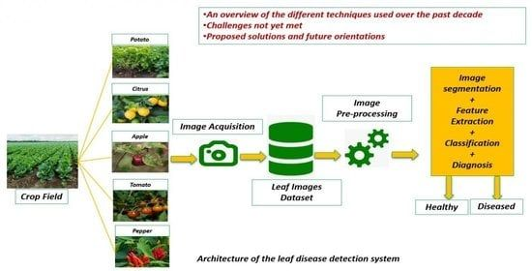
PROBLEM STATEMENT
Crop diseases lead to severe harvest reductions and critical economic losses for farming communities worldwide.
Delayed identification allows pathogens to spread rapidly across fields before corrective interventions can be deployed.
Manual tracking requires expert agronomist intervention, which is scarce and expensive.
The Need: An automated computer vision-based system that analyzes leaf images and provides rapid crop disease classification with a clear prediction result.

Slide 6
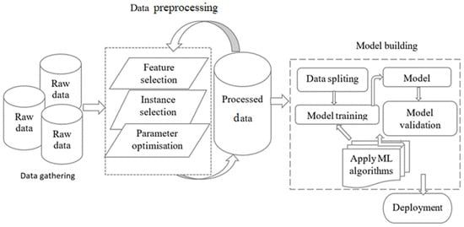
Objectives
Develop a computer vision-based framework to identify crop leaf diseases from images and support early disease detection.
Train a deep learning image classification model using a labeled plant disease image dataset.
Replace subjective manual inspections with rapid, reliable computer algorithms.
Provide a simple web interface that allows users to select the provided leaf images and view the predicted disease and confidence score.

Slide 7
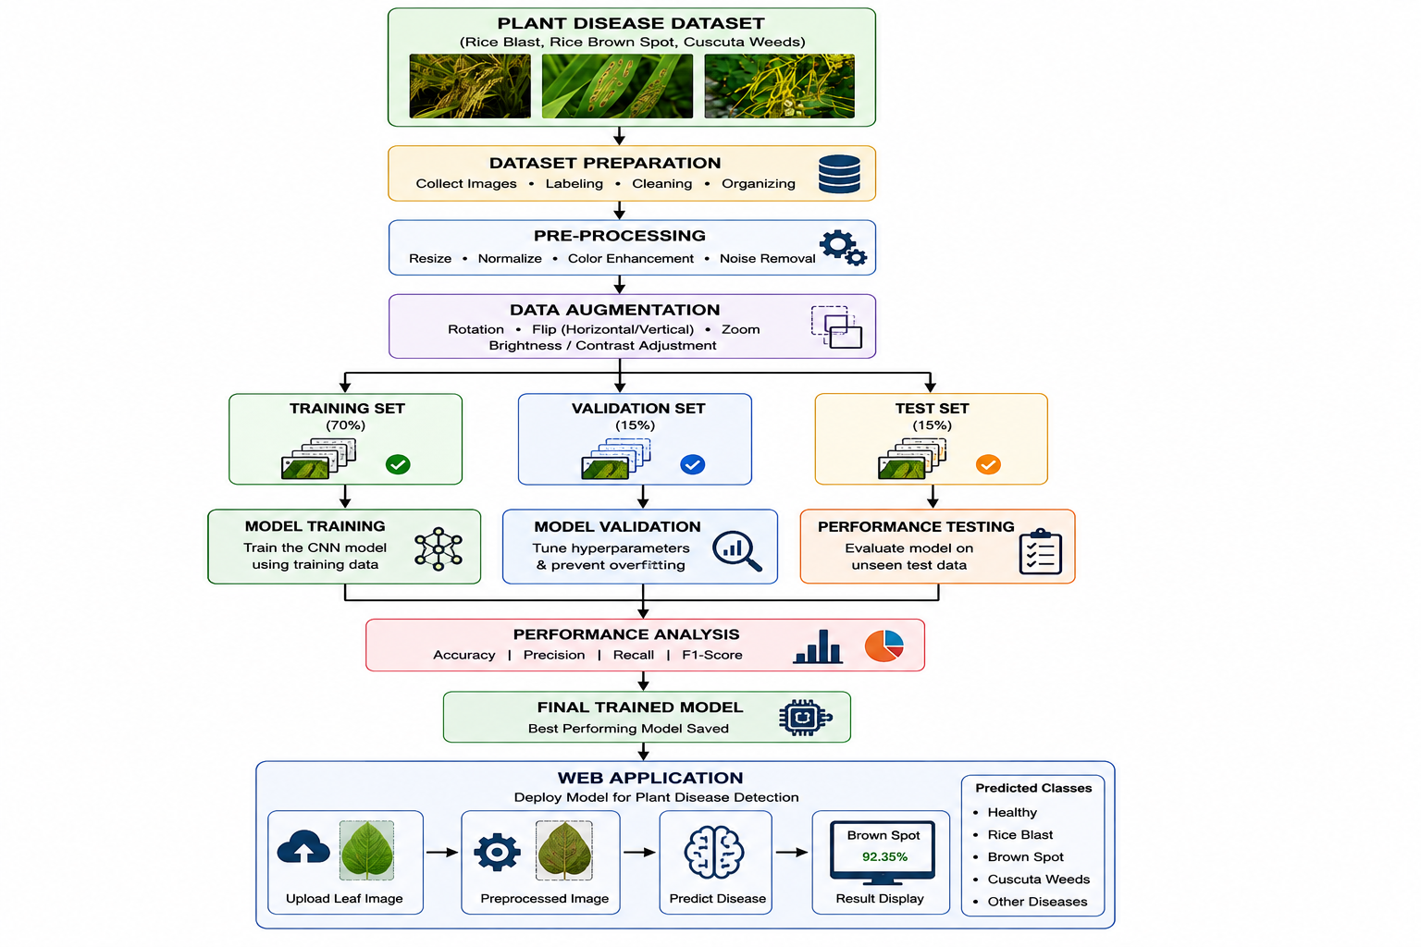
SYSTEM ARCHITECTURE

Slide 8
MODULE 1: Leaf Image Selection and Preprocessing
Leaf Image Selection: The web application provides a set of leaf images for analysis, and the user selects one of the provided images.
Resizing & Standardization: Uniform scaling of image resolutions to match network constraints.
Data Augmentation: Rotation, flipping, zooming, and brightness variation are applied to training images to improve model generalization.
Training Preprocessing: Training images are resized, normalized, and augmented to improve model generalization and reduce overfitting.
Prediction Preprocessing: The selected leaf image from the web application is resized and normalized according to the trained model's input requirements.

Slide 9
MODULE 2: Feature Extraction and Computer Vision Models
Feature Extraction: The trained deep learning model extracts important visual features such as leaf color, texture, shape, and disease patterns.
Feature Learning: The model learns the characteristic patterns associated with different healthy and diseased leaf classes during training.
Classification: The extracted features are used to classify the selected leaf image into its corresponding disease category.

Slide 10
MODULE 3: PREDICTION AND RESULT VISUALIZATION
Image Selection: The user selects one of the provided leaf images from the web application for analysis.
Prediction: The selected leaf image is passed through the trained classification model to predict its disease category.
Result Visualization: The webpage displays the predicted disease and confidence score for the selected leaf image. The model predicts the corresponding disease class from the available trained categories.

Slide 11
MODULE 4: Model Training and Optimization
Dataset Preparation: The plant disease image dataset is divided into training, validation, and test sets for model development and performance evaluation.
Model Training: The deep learning classification model is trained using the training images and their corresponding disease labels.
Hyperparameter Optimization: Important training parameters such as learning rate, batch size, and number of epochs are adjusted to improve model performance.
Overfitting Control: Appropriate training techniques are used to improve validation performance and reduce overfitting.

Slide 12
MODULE 5: WEB APPLICATION INTEGRATION
Model Integration: The trained disease classification model is integrated into the web application to process the selected leaf images.
Leaf Image Selection: The web application provides a set of leaf images, and the user selects one of the provided images for prediction.
Prediction Display: After processing the selected image, the webpage displays the predicted disease and confidence score.
User Interface: The web application provides a simple interface for selecting leaf images and viewing the prediction results.

Slide 13
RESULTS AND DISCUSSION
Model Performance: The trained model is evaluated using test images to determine its disease classification performance.
Prediction Result: The web application successfully processes the provided leaf images and displays the predicted disease.
Observation: The model is able to identify disease patterns from the selected leaf images based on the features learned during training.
Discussion: Misclassification may occur when different diseases have visually similar symptoms, highlighting the importance of a sufficiently large and diverse training dataset.

Slide 14
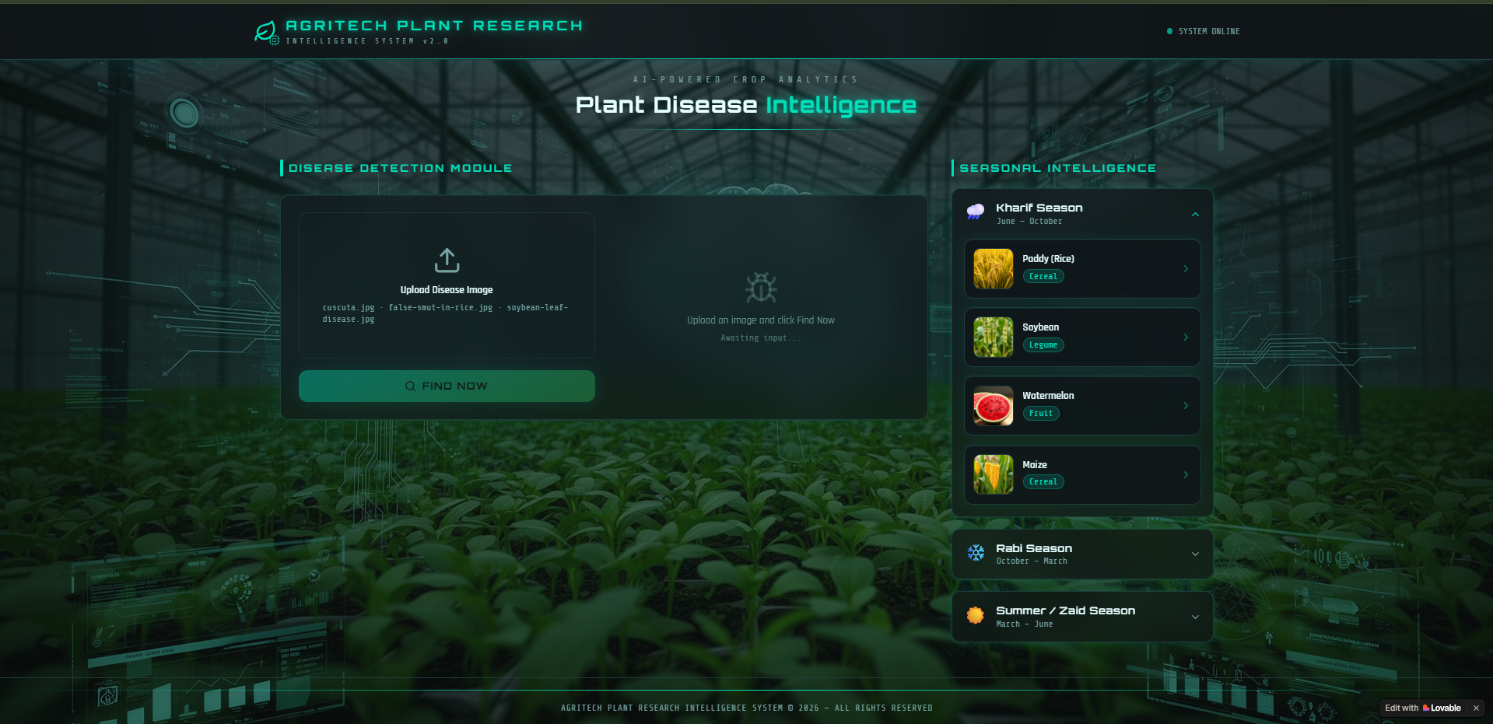
SCREENSHOT - IMPLEMENTATION

Slide 15
APPLICATION
Farmers and Growers: A simple web-based tool for analyzing selected leaf images and obtaining rapid disease predictions.
Agricultural Advisors and Extension Services: A decision-support tool that assists in preliminary disease identification from leaf images.
Nurseries and Agri-Businesses: Automated screening of plant leaf images to support crop health monitoring and disease identification.

Slide 16
CONCLUSION
Summary: The project develops a deep learning-based system for classifying crop leaf diseases from images. The trained model is integrated into a web application where the provided leaf images can be selected for prediction.
Impact: The system provides a fast and consistent method for preliminary crop disease identification through a simple web interface.
Future Scope: The system can be extended to support more crops and diseases, real-time camera-based image capture, mobile deployment, and additional agricultural data for improved disease monitoring.

Slide 17
REFERENCES
Kuhn, M., & Johnson, K. (2013). Applied Predictive Modeling. Springer.
Witten, I. H., Frank, E., Hall, M. A., & Pal, C. (2016). Data Mining: Practical Machine Learning Tools and Techniques. Morgan Kaufmann.
R Core Team. (2023). R: A Language and Environment for Statistical Computing. R Foundation for Statistical Computing.
Food and Agriculture Organization (FAO). (2022). Plant Disease Management for Sustainable Agriculture.
Dataset: Plant Disease Dataset, obtained from Kaggle and used for model training and evaluation.

Slide 18


